Slide 1

Analytics Applications for Smart Living
Project Presentation
Team Accelerate
Notes:
Good Morning everyone, We are team Accelerate. Let us start off by watching a quick video.

Slide 2


Slide 3
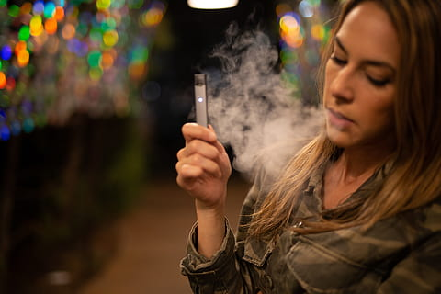
Background
3x
61%
83%
Vapes cases found in 2021 compared to 2019 in Singapore
US Study shows that 61% saw co-workers vaping and 19% admitted vaping themselves
Reddit Study shows that 83% of those that wants to quit are young working adults
‹#›
Notes:
Let me tell you more about the vaping epidemic that many countries are facing today. In Singapore, there has been 3 times the number of vape cases in 2021 compared to just 2 years back.
A 2019 Survey conducted in the US about the vaping prevalence in workplace showed that 61% of the respondants have seen their co workers vaping.
While this is some worrying news, we can see from a Reddit study that 83% of those that want to quit are YWAs.
https://journals.lww.com/joem/Fulltext/2021/01000/Vaping_in_the_Workplace__Prevalence_and_Attitudes.2.aspx#:~:text=Majority%20(61.6%25)%20observed%20coworkers,workplace%20productivity%20among%20non%2Dusers.
https://www.channelnewsasia.com/singapore/significant-increase-vape-cases-recent-years-hsa-steps-enforcement-2718246
https://www.jmir.org/2021/10/e28303/

Slide 4
Problem Statement
We aim to understand the perception and root causes of vaping amongst the Young Working Adults (YWA), focusing on workplace stress and social pressure.
The outcome is to derive targeted and effective solutions to help motivate YWAs to quit vaping.
Notes:
SO this brings us to our problem statement. We want the understand the relationship between workplace stress as well as social pressure AND vaping amongst the young working adults (18-35).
This would help us to suggest some effective solutions to help motivate YWAs to quit.

Slide 5
Stakeholders
Young Working Adults aged between 18-35 years old
Currently, highest population of e-cigarette users that have never smoked cigarettes is from 18-24 years old group.
Trend where people who vape are more likely to smoke cigarettes in the future.
Since it is still generally new, no findings about long term effects
Initially conducted interviews with 7 people consisting of vapers and non vapers.
Notes:
Our stake holders are YWAs aged between 18 and 35 years old. We think that this is an important issue particularly for this group because the highest population of vape users that do not smoke conventional cigg is from this age group.
There is an increasing trend seen where people who vape later go on to smoke cigarettes in the future
More importantly, there are no findings about long term health effects because this is a particularly new trend.
To understand our stakeholders, we carried out face to face interviews with 7 people to understand about their perception on vaping with questions based on 6 themes..
Age 18-35
Young working adults > vapers
Young working adults > non-vapers

Slide 6
Interview Insights (N=7)
Workplace
-some mention vape more during workplace
- some mention vape more due to work stress
Quitting
- wants to try to quit but feels lack of resources
- many people have at least once tried to quit
Legal
- Knows it is illegal to vape
- Feels that it can usually be let off as a warning
- Simply do not care about the law
Health
- Did not care about their health despite knowing it has nicotine
- Feels that it is healthier
- Understands the consequences but still does it
Family
Most of them do not tell their parents
Felt that parents have no control on their choices
General - Why start?
- Friends, social influence
- Try out new experiences
- Stress reliever
- Curious from young
Notes:
The 6 themes being ______________________________________
Some insights we got from this interview is that

Slide 7

Sub Themes from Social Media and Interview
While banned in Singapore, young adults see continued use of e-cigarettes or vapes.
Workplace
Quitting
Health
Legal
Family
General
Notes:
Hence, with this insights, we decided to focus on workplace stress, social pressure and quitting.

Slide 8
Research Design
After Interviews, we planned to carry on with research using various methods such as:
Initial Findings
Descriptive Analysis
Clustering
Decision Tree Classification
Persona with empathy mapping
Word Cloud
Topic Modelling
Social media analysis
Survey
Solution
Interview
Notes:
So after the interview we continued our research by conducting social media analysis
We also constructed our survey questions based on the insights we have collected from the interview
From there, we carried out other methods of analysis such as descriptive analysis, clustering and more which will be explained later on.

Slide 9
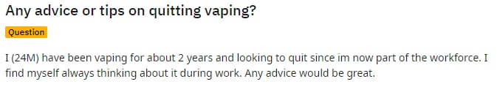
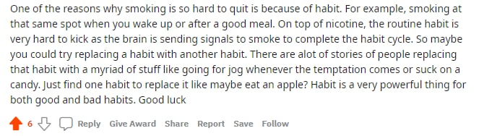
Data
Update on Social Media Data:
Reddit
Paiseh Question (Telegram)
Twitter
Survey:
75 Respondents
Reply from Reddit:
Notes:
Unfortunately, we did not have much success with any social media findings.
For Reddit, there was a lack of response in the Singaporean subreddit channels that we posted on. From the sceen, you will find our best and only quality reply was about trying to find a new habit to distract the quitter from the nicotine crave
We sent a few questions to Paiseh Question on Telegram but they did not post our question
As mentioned before, there was insufficient information on Twitter concerning our stakeholders
We also managed to get 75 Respondents for our survey, which we will talk about more

Slide 10
Survey Analysis
Notes:
Now i will be moving on to the survey analysis

Slide 11
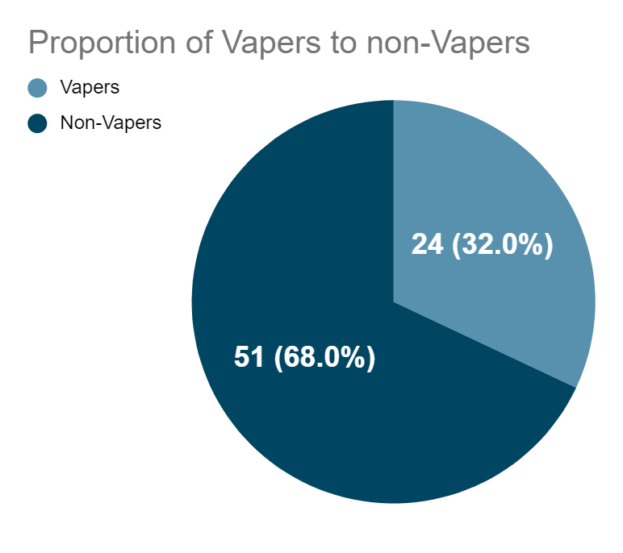
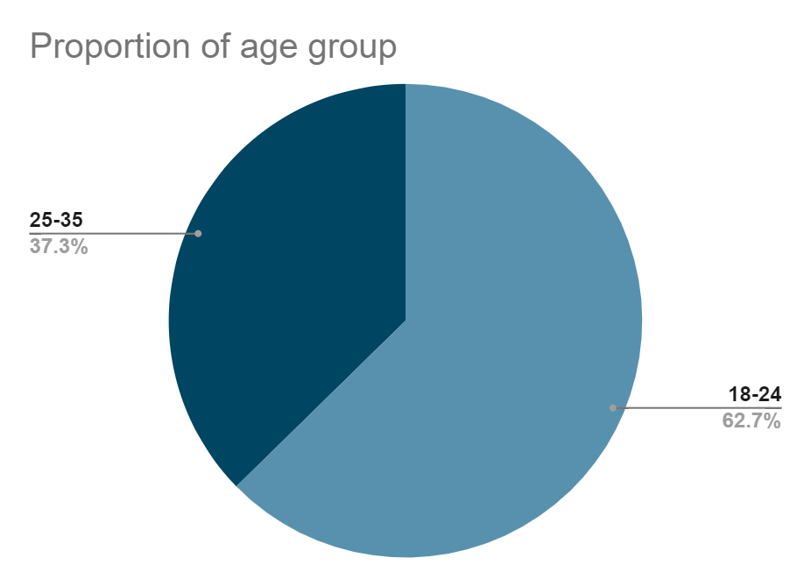
Survey Responses Overview
N=75
Notes:
Starting with the basic information about our survey and demographics, we collected data from 75 surveyees and majority of the respondents are aged 18-24, with 32% vapers and 62.7% non-vapers. Just to clarify, we group people that vaped more than once under vapers (even if they have tried it just once because we identify them as potential future users)

Slide 12
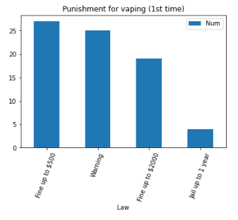
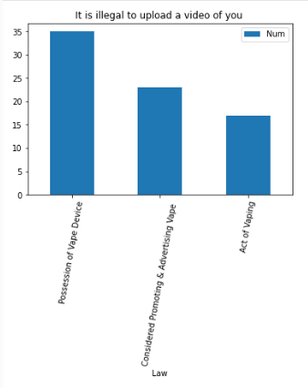
Knowledge of laws
Notes:
To learn more about the background of these respondents, we tested on their legal knowledge of the current laws regarding vaping and from the results, most of the respondents do not know the law for 1st time punishment, and similarly the consequences of uploading a video of them vaping. This shows that most of the YWA are uninformed about the legal consequences of vaping.
From the survey results:
The correct answers are:
Q1: Fine
With effect from 1 February 2018, the use, purchase or possession of vaporisers is also an offence and is punishable with a fine up to $2,000.
Repeat offenders could be fined up to S$20,000, jailed for up to one year, or both.
Q2: Considered Promoting and Advertising Vape
Any advertisements and promotions relating to tobacco products and imitation tobacco products are prohibited under the law.
You cannot publish any advertisements relating to tobacco products and imitation tobacco products.

Slide 13
Workplace Factors Analysis
Notes:
So now i will talk more about findings regarding workplace factors

Slide 14
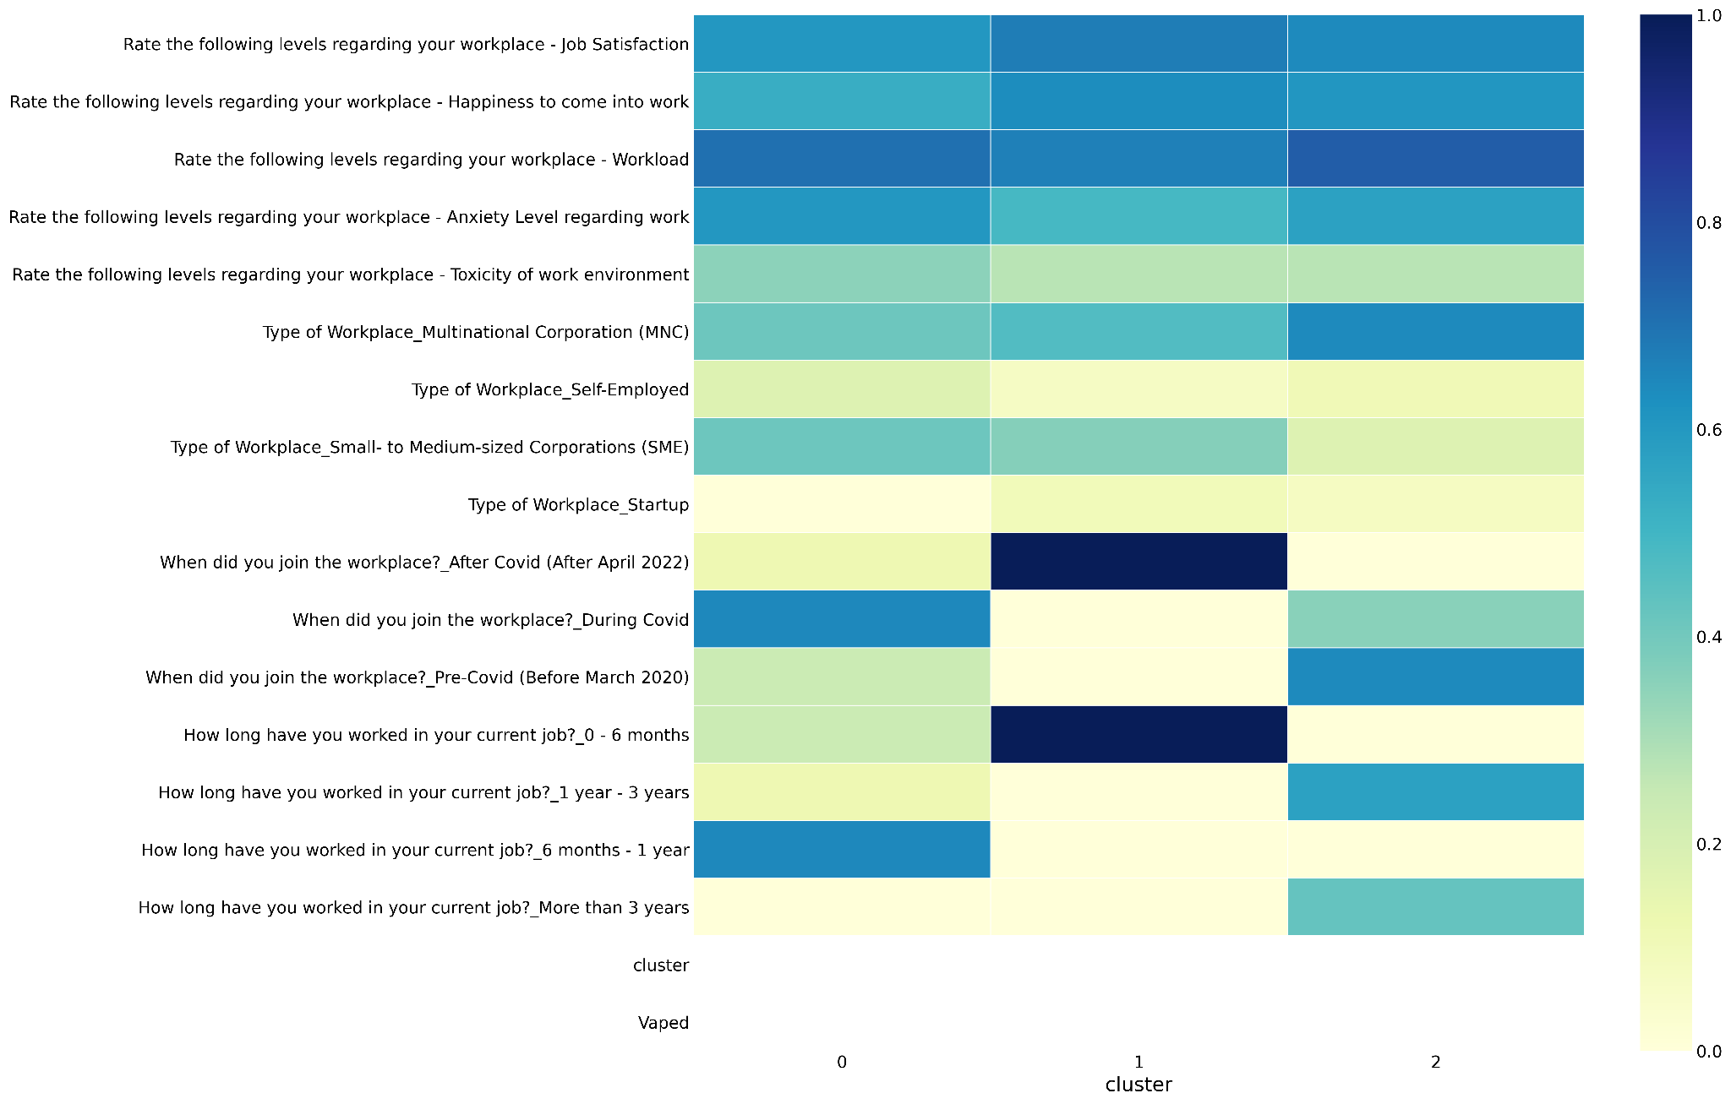
Clustering on Workplace factors (Segmentation)
Objective of clustering on work background is to identity groups of people from our survey based on similar workplace factors
Factors used:
Type of Workplace
When did you join the workplace?
How long have you worked in your current job?
Job Satisfaction (Rate from 1-5)
Happiness to come into work (Rate from 1-5)
Workload (Rate from 1-5)
Anxiety Level regarding work (Rate from 1-5)
Toxicity of work environment (Rate from 1-5)
Clustering heatmap result
Notes:
We were interested to understand the different profiles of our surveyees related to their workplace in order to find whether there’s a connection between their workplace and vaping
To do so, we did clustering on workplace factors and some factors includes the type of workplace, when they joined as well as ratings about their working conditions such as workload and anxiety levels.

Slide 15
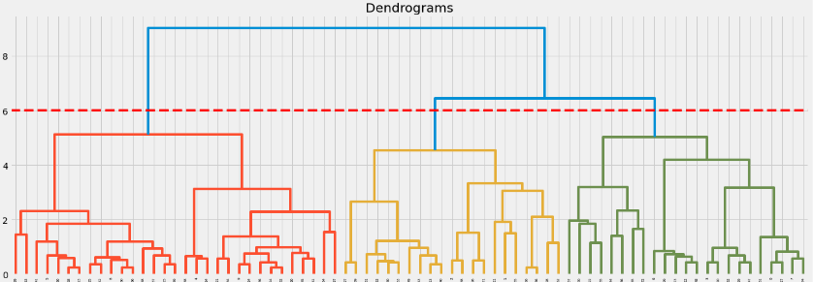
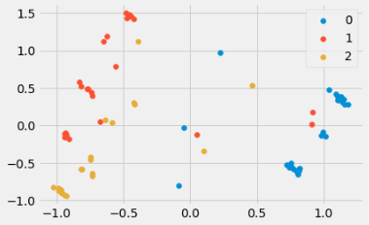
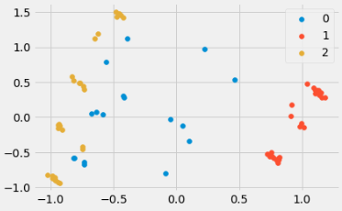
Clustering on Workplace factors
Number of clusters is decided from the dendrogram. Y=6 cuts across 3 clusters which is not too segmented and give more insights.
We ‘euclidean’ for affinity and ‘ward’ as linkage, where euclidean measures the shortest distance between two points. Since the data is not high-dimensional (our number of features is less than number of observations n=75), euclidean is still a meaningful distance metric.
We did both Hierarchical and GMM clustering. Results from GMM soft clustering was chosen because the PCA graph shows a clearer segmentation of the cluster.
Hard clustering was rejected due to overlapping and more noise between clusters.
Hard clustering (Hierarchical)
Soft clustering (GMM)
Notes:
https://carpentries-incubator.github.io/high-dimensional-stats-r/01-introduction-to-high-dimensional-data/index.html

Slide 16
Clustering on Workplace factors - Heatmap
This is an enlarged version of the heatmap results, interpretation is on the next slide.

Slide 17
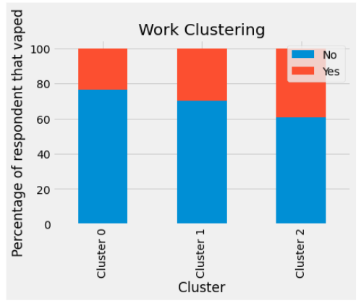
Q:Have you vaped before?
Interpretation of the Clustering on Workplace factors
Information here is summarised in the next slide
 | Cluster 0 | Cluster 1 | Cluster 2
Join Workplace | during covid | after covid | during covid/mostly pre-covid
Worked in current job for | 6 months - 1 year | 0 - 6 months | > 1 year
Type of workplace | MNC, SME | MNC, SME | MNC
Satisfaction | Medium | Highest | Medium
Happiness | Medium | Highest | Medium
Workload | High | Medium | Highest
Anxiety | Medium | Low | Medium
Toxicity | Low | Low | Lowest
 | Smallest, least proportion of vapers | Most ppl here, 30% vape | Next largest group with higher proportion of vapers 40%
Raw numbers of response
 | Cluster 0 | Cluster 1 | Cluster 2
Never Vaped before | 13 | 21 | 17
Vaped before | 4 | 9 | 11
Total | 17 | 30 | 28

Slide 18
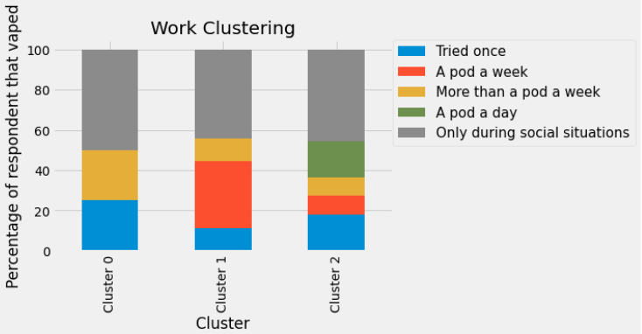
Workplace Profiles
Cluster 0
Join during covid
High satisfaction & happiness
High workload
Medium anxiety
Low toxicity
Frequency of vaping in each cluster
Cluster 2
Join during/pre covid
High satisfaction & happiness
Highest workload
Medium anxiety
Lowest toxicity
Cluster 1
Join after covid
Highest satisfaction & happiness
Medium workload
Low anxiety
Low toxicity
Pre-Covid (Before March 2020)
After Covid (After April 2022)
Notes:
From the results, we summarised the characteristics of the 3 distinct groups amongst our surveyee. The most prominent factors being the duration of when they joined their job.(before,during or after covid)
As you can see from the clusters most of them have varying degrees of rating regarding their workplace. we could see where most of the heavy vapers (the ones in green) falls into cluster 2, which has the highest workload. Also, many of the people that tried vaping once fell into cluster 0, these people joined the workplace during covid and could be a reason that they were introduced to vaping at that period. However more data would be required to confirm the relationship between the period they join and their workplace stress level.
Explain on the workplace >
Highest take up of vapers > (covid > highest pickup but become a social vaper)
-limitation of the data
Solution relatable to work ()

Slide 19
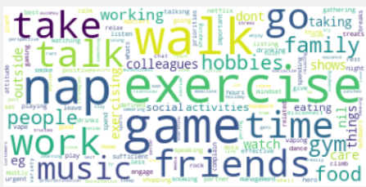
How people cope with workplace stress and anxiety?
So what are the reasons why people continue to vape in the first place?
Notes:
Most of the coping mechanisms stated are positive such as exercising, games, music, friends, so what are the reasons why people continue to vape in the first place?

Slide 20
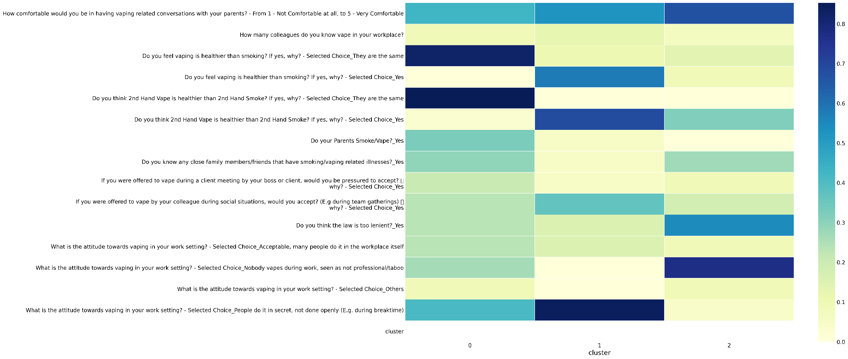
Clustering on Vaping perception (Segmentation)
Objective of clustering on vaping perception is to find the groups of people from our survey based on the their views regarding vaping
Factors used:
Do you feel vaping is healthier than smoking?
Do you think 2nd Hand Vape is healthier than 2nd Hand Smoke?
Do your Parents Smoke/Vape?
How comfortable would you be in having vaping related conversations with your parents? (Rate 1-5)
Do you know any close family members/friends that have smoking/vaping related illnesses?
How many colleagues do you know vape in your workplace?
What is the attitude towards vaping in your work setting?
If you were offered to vape during a client meeting by your boss or client, would you be pressured to accept?
If you were offered to vape by your colleague during social situations, would you accept? (E.g during team gatherings)
Do you think the law is too lenient?
Clustering heatmap result
Notes:
For a more insightful finding, we did clustering based on vaping perception which included factors such as health, family, law, attitude towards vaping in work setting and qns regarding social pressure to find the similar characteristics in each group.

Slide 21
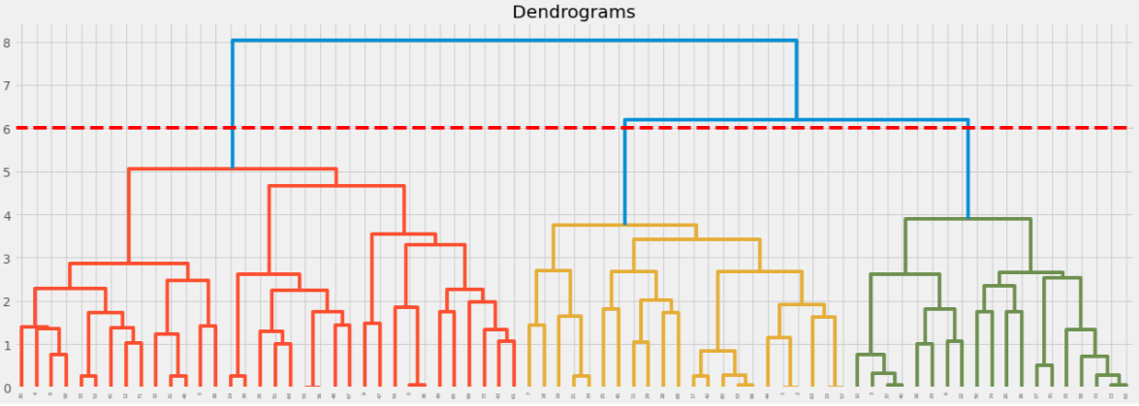
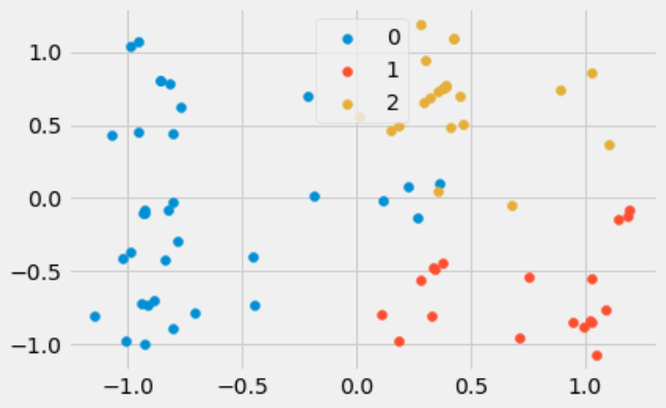
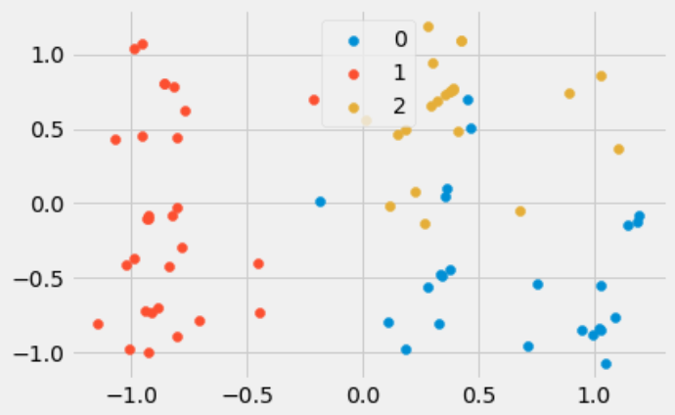
Clustering on Vaping perception
Number of clusters is decided from the dendrogram. Y=6 cuts across 3 clusters which is not too segmented and give more insights.
We ‘euclidean’ for affinity and ‘ward’ as linkage, where euclidean measures the shortest distance between two points. Since the data is not high-dimensional (our number of features is less than number of observations n=75), euclidean is still a meaningful distance metric.
Hard clustering was chosen because the PCA graph on the outcome of the result shows a clearer segmentation of the cluster
Soft clustering was rejected due to overlapping and more noise between clusters.
Hard clustering (Hierarchical)
Soft clustering (GMM)

Slide 22
Clustering on Vaping perception - Heatmap

Slide 23
Interpretation of the Clustering on Workplace factors
 | Cluster 0 | Cluster 1 | Cluster 2
Comfortable talking to parents about vaping | Medium | High | Highest
Vaping healthier than smoking | They are the same | Yes | No
2nd hand vape healthier than smoke | They are the same | Yes | Mostly no
Parents smoke/vape | Some yes | No | No
Know people with smoke/vape related illnesses | Some yes | No | Some yes
If offered to vape by boss/client | Some accept | Do not accept | Do not accept
If offered to vape by colleagues | Some accept | Some accept | Few accept
Law too lenient | Some say yes | No | yes
Workplace attitude | People vape during breaktime/in secret | People vape during breaktime/in secret | Nobody vapes during work
Raw numbers of response
 | Cluster 0 | Cluster 1 | Cluster 2
Never Vaped before | 21 | 12 | 18
Vaped before | 13 | 7 | 4
Total | 34 | 19 | 22

Slide 24
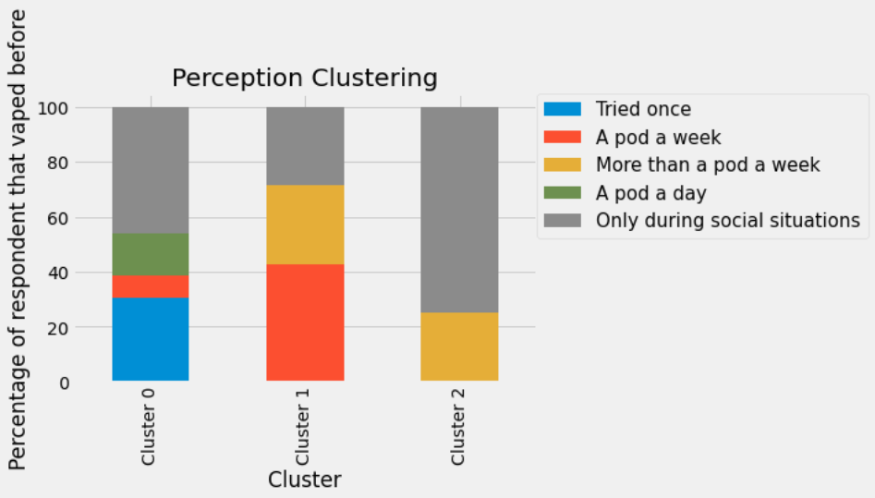
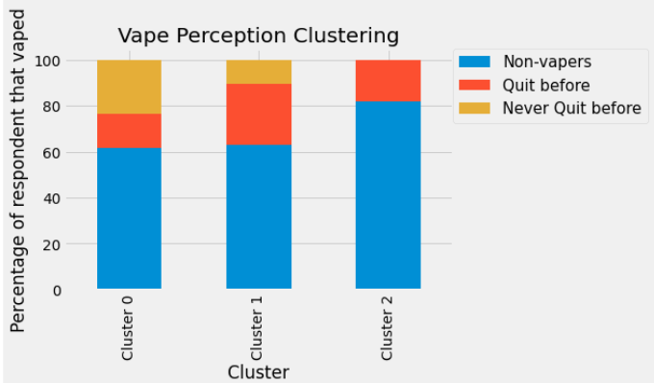
Vape Perception Clustering
Frequency of vaping
Cluster 0
- Think vaping and 2nd hand vape same as smoking
- Some accept vape from boss/client/colleagues
-Exposed to vaping during work
-Parents vape/smoke
-Aware of vape/smoke risk
Cluster 2
-Think vaping and 2nd hand vape not healthier
-Group that does not accept vape
-Not exposed to vaping during work
-Parents do not vape/smoke
-Aware of vape/smoke risk
First time/heavy users
Proportion of people that quit vape before
Cluster 1
-Thinks vaping/2nd hand vape healthier than smoking
-Would accept from colleague
-Colleagues vape during work break
-Parents do not vape/smoke
-might not be aware of vape/smoke risk
Social vapers
Frequent users
Notes:
We manage to get 3 different cluster groups and each group is distinctly different in terms of factors such as their health perception about vaping vs smoking, whether they would accept vape from boss or colleagues and workplace attitude towards vaping. The largest group belong to cluster 0, followed by cluster 2 and then cluster 1.
(CLICK)
Based on the frequency of vaping, we manage to label each cluster representatively. heavy vaper (in green) (CLICK) and first time vaper falls into cluster 0 who thinks that vaping and smoking have similar health effect.
Majority of the people belongs to this cluster, showing that the many ppl might view smoke and vape as alternatives.
Frequent vape users fell into cluster 1(CLICK) who thinks vape is healthier than smoke and are not aware of vaping health risk
And lastly the social vapers fall into cluster 2(CLICK). ironically this is the group that does not accept vape from boss or colleagues, showing that there could be external social pressures that causes them to smoke socially such as their close friends or other social groups.
(CLICK) As seen in the chart of proportion of people that quit vape, many people have quit vape or attempted quitting before, this shows that many do have the idea and motivations to quit but might have trouble doing so. Later on, we will be discussing the problems that each group of vapers might face.
Next zhe bin will talk about decision tree to find out which factors are impt from this clustering.

Slide 25
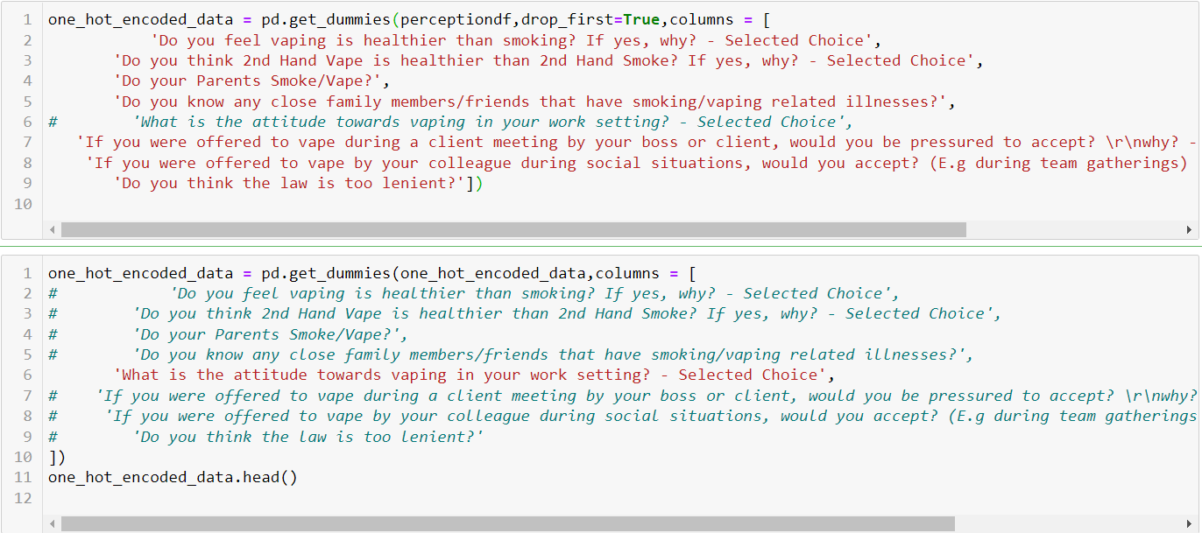
Decision tree based on perception cluster
For the inputs for the decision tree to determine the important factors that group the clusters, we used the same inputs as in the clustering model. We perform the same encoding here as well.

Slide 26
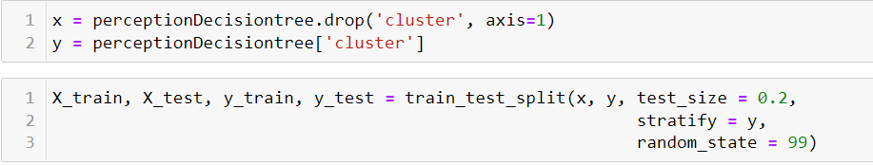
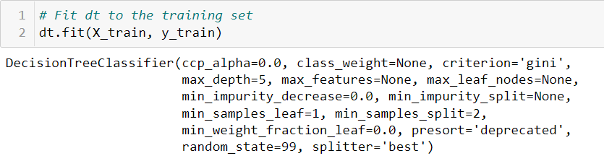
Decision tree based on perception cluster
We use the input features from the previous slide as our x, and for our y we use the cluster labels given by the clustering model beforehand. We then perform a train_test_split with a 20% test size of 15 data points and 80% train size of 60 data points, with random state of 99. We then fit the datasets into a decision tree model
Parameters:
Max_depth = 5: limited maximum number of decision tree splits to 5 to prevent overfitting
Criterion = ‘gini’: Used gini impurity for the calculation of the quality of a split in our decision tree

Slide 27
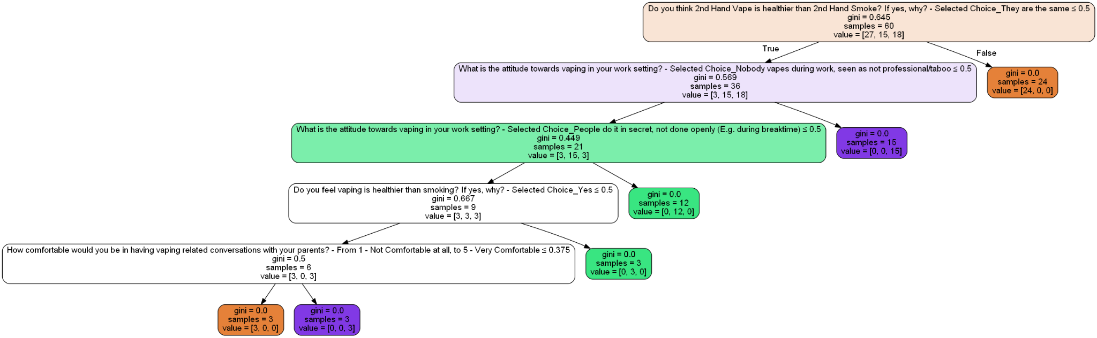
Decision tree based on perception cluster

Slide 28
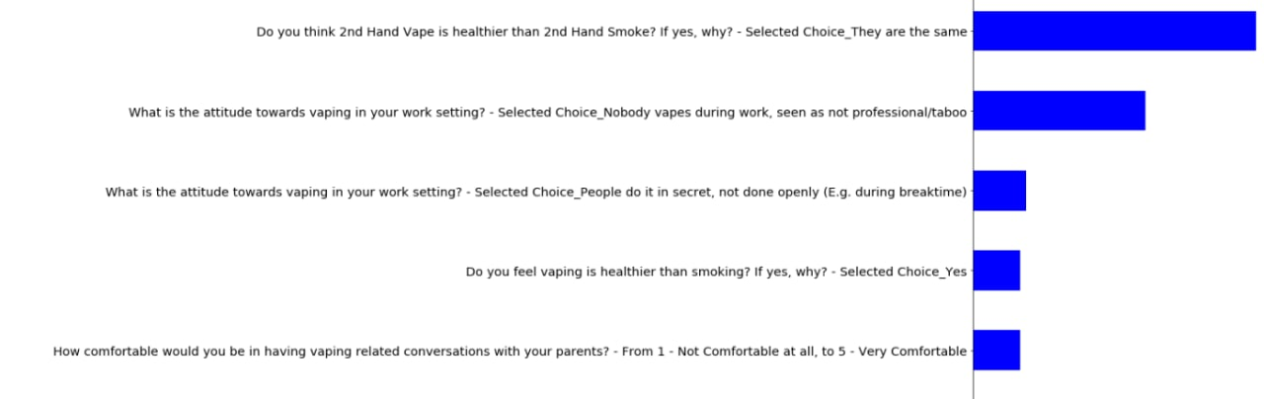
Decision Tree Findings
Cluster 0 (First time/heavy users): 2nd hand vape as healthy as 2nd hand smoke → Do not know health impacts of vaping or do not care
Cluster 1 (Frequent users): thinks 2nd hand vape is healthier than 2nd hand smoke →, others vape in secret/during breaktime in the workplace → frequent users → expose to vaping culture in workplace?
Cluster 2 (Social Vapers) thinks 2nd hand vape and 2nd hand smoke are not the same → nobody vapes at work, looked down upon → external forces of social pressure (from friends), might only vape due to social pressure
Is 2nd hand vape as healthy as 2nd hand smoke
Vaping is unprofessional in the workplace
Vaping at work in secret
Vaping is healthier than smoking
Not comfortable with having vaping conversations
Hence, health perception, workplace culture and openness with parents might have a connection to the different types of vapers (explains why people fall into the different groups)
Notes:
From the decision tree model output, we found out that the top 5 factors that determine how people fall into the different cluster is (in order):
Whether 2nd hand vape is healthier than smoke
Whether the workplace approves of vaping in the workplace
Whether people vape in secret in the workplace
Whether vaping is healthier than smoking
Whether they are comfortable in having vaping related conversations with their parents
Cluster 0:determining factor is perception on whether 2nd hand vape healthier than smoke (thinks same) > first time/heavy user >shows that people don’t know the health effects whether u vape or not, ppl DC
Cluster 1:thinks 2nd hand vape is healthier than 2nd hand smoke are not the same, done in secret/during breaktime > frequent users > expose to vaping culture in workplace?
Cluster 2: thinks 2nd hand vape and smoke not the same, nobody vapes in work> social vapers > external forces of social pressure (from friends), don’t view vape and smoke the same so they might be more open to vape than smoke?
Hence> health perception, workplace culture and openness with parents might have a connection to the different types of vapers (explains why people fall into the different groups))

Slide 29
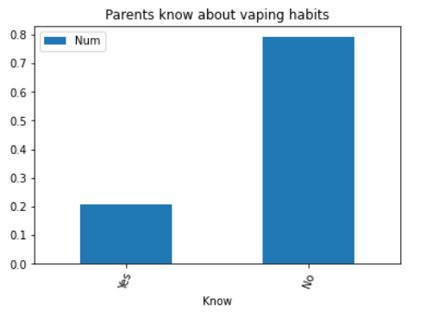
Findings
As seen in one of the factors of comfortability talking to parents, despite most of the respondent saying they are comfortable talking about vaping related topics with their parents, our findings showed that most of the parents of respondents that vaped before do not know about their children’s vaping habits. This shows that more can be done in terms of parental support which could potentially mean a lot to these young working adults.

Slide 30
Finding Important Factors Leading to Vaping
Age Range | Is Vaping Healthier than Smoking
Sex | Is 2nd hand Vape healthier
Marital Status | Do your parents smoke/vape
Race/Ethnicity | Any close family members friends with smoking/vaping related diseases
Highest Education Qualification | Workplace toxicity/workload/job satisfaction
Industry Sector | Number of colleagues that vape their workplace
Type of Workplace | Attitude towards vaping in the workplace
Type of Job | Would they accept a vape from their boss/client
When they joined | Would they accept a vape from their colleague
How long they have worked | Laws regarding vaping and their leniency
Notes:
All characteristics except those that are related to vaping themselves, like how long they vape or how much they vape.

Slide 31
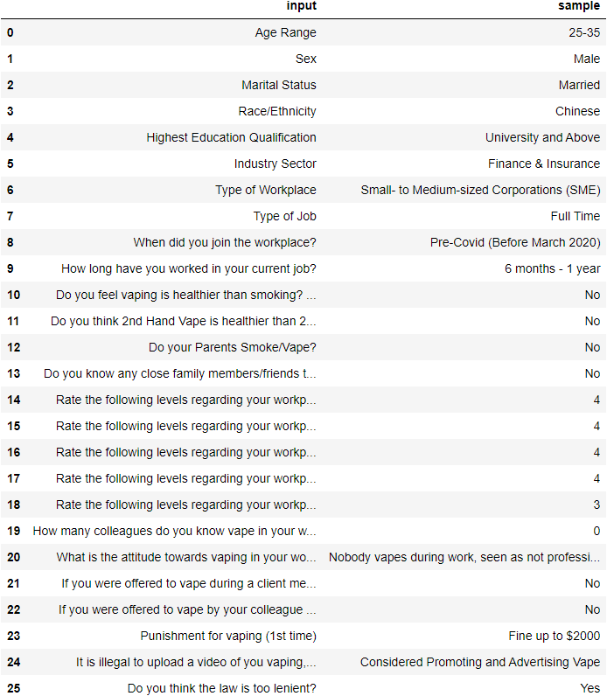
Preparation for Logistic Regression
Step 1 -> Create subset of dataset with the inputs in fig 1 from the Masterfile of survey results
Fig 1

Slide 32
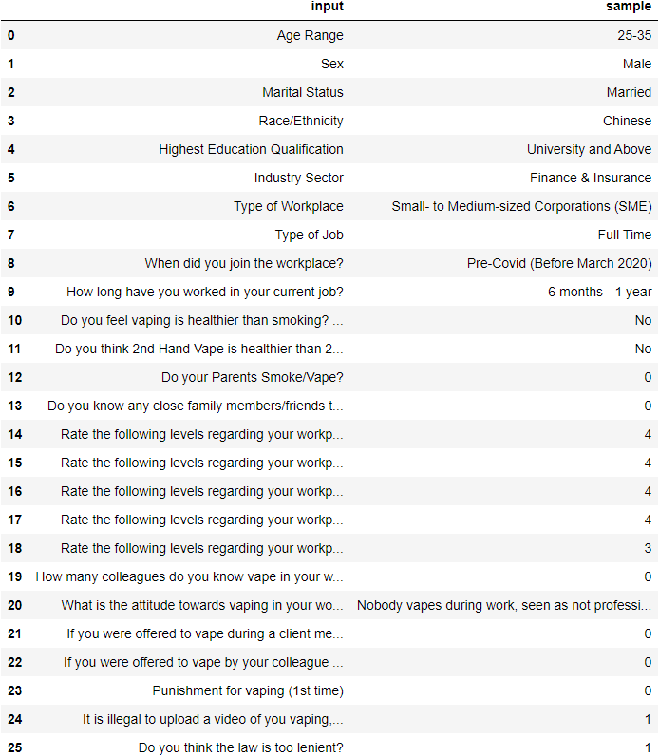
Preparation for Logistic Regression
Step 2 -> Map Yes/No answers to 1/0 except for the vaping healthier than smoking questions, map questions about law to 1 for correct answer, 0 for wrong answer
Fig 2

Slide 33
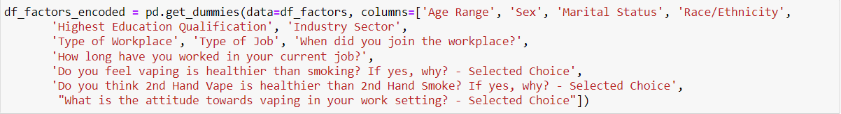
Preparation for Logistic Regression
Step 3 -> dummy encode the non numerical values in figure 3
Fig 3
Step 4 -> set X as the encoded features and y as whether the person is a vaper or not, with yes mapped to 1 and no to 0 (Fig 4)
Fig 4
Step 5 -> Perform train test split with the parameters in Fig 5
Fig 5

Slide 34
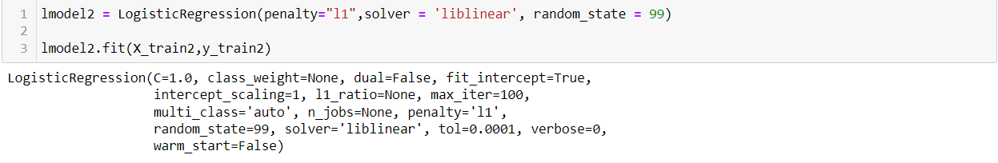
Preparation for Logistic Regression
Step 6 → Train a Logistic Regression Model using the X-train and y_train from the previous train test split
Fig 6
Penalty = l1 → L1 regularization, reduces the coefficients of the features in the regression model, changing coefficient of low contribution features to 0 and getting rid of them from the end result, allowing us to see only the more important features.
Solver = Liblinear → Allows use of L1 regularisation

Slide 35
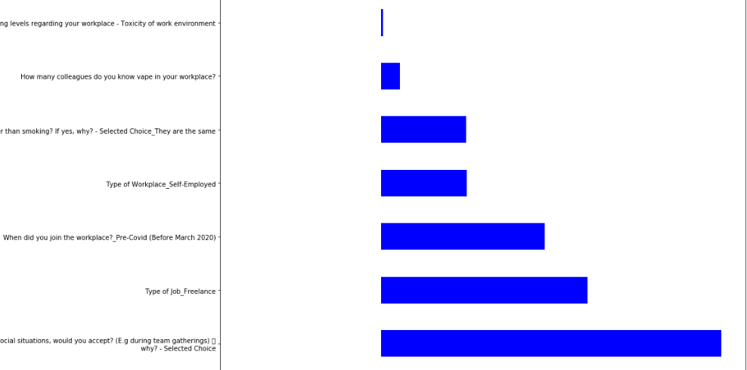
Logistic Regression Output
Toxicity of work environment
Know more colleagues who vape at work
Vaping is just as unhealthy as smoking
Self-Employed Worker
Started Working Pre-Covid
Freelance Worker
Would Accept a vape from colleagues if offered during a social event
Notes:
The outputs from the Logistic Regression Model
The most important feature contributing to if a person is a vaper or not seems to be whether they answered yes to the question whether they would accept an offer to vape from their colleagues during social situations. This feature implies that many of the vapers give in easily to social pressure. Other features shown here like being self-employed or freelance worker seems to imply that people are more likely to vape if they have less responsibility to their company. There also seems to be a bit of a link of toxic work environments and knowing more vapers at work leading to a higher chance of a person being a vaper.

Slide 36
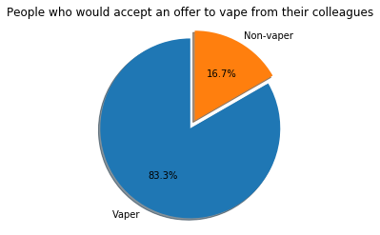
Logistic Regression Output
Notes:
Indeed, out of the 18 people who answered yes to this question, 83.3% of them are vapers. This feature on social pressure would be an important one to take into consideration when coming up with our solution.

Slide 37
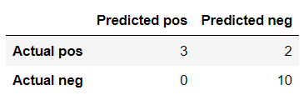
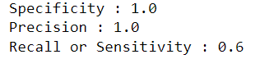
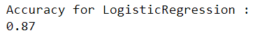
Evaluation of Logistic Regression Model
For our Logistic Regression Model, we achieved an accuracy 0.87, which is good a good performance, but we have to take into account the fact that we have quite a small sample size of 75 with a very small amount of vapers in the dataset. However, under Central Limit Theorem, our sample size is still >30, suggesting that it is normally distributed and suitable for estimating the population statistics.
The model has a lower recall of 0.6, suggesting that it is not very good at identifying a majority of vapers. This is probably explained by the lower amount of non-vapers compared to vapers in our dataset. We can still use the important features in the model to predict a certain type of vapers, which in our case is the social vaper.

Slide 38
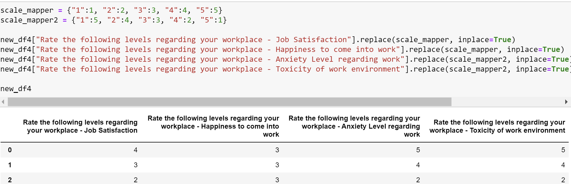
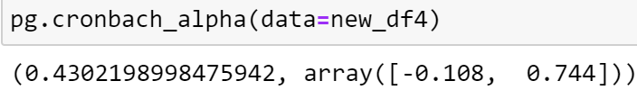
Cronbach Reliability
We decided to carry out Cronbach’s alpha reliability test on 5 questions that were answered on a likert scale. We got a rather low cronbach alpha of around 0.4 hence we dropped the factor of “Workload” However, even after dropping that column and using reverse encoding, the cronbach alpha remained at 0.43 and we were unable to draw any overall conclusions for our 4 questions.

Slide 39
Modelling and Analysis - Word Clouds
Import libraries
Load excel sheet
Clean excel sheet:
nan_value = float('NaN')
data_nil = data.replace(nan_value, ' ')
data_nil
Create Text to be used for word cloud:
text = ''.join(sentence for sentence in data_nil['What are some resources that you think would help others quit?'])
Add Stopwords, ‘Didn’t’ was translated to ‘Didnâ’ and ‘t’ from qualtrics:
stopwords = set(STOPWORDS)
stopwords.update(['smoking', 'vape', 'vaping', 'think', 'way', 'addicted', 'addiction', 'quit', 'Nil', 'want', 'Didnâ', 't', 'cost', 'tax', 'legalisation'])
Create wordcloud:
wordcloud = WordCloud(stopwords=stopwords, background_color = 'white').generate(text)
plt.imshow(wordcloud)
plt.show()
Repeat process for other survey questions

Slide 40

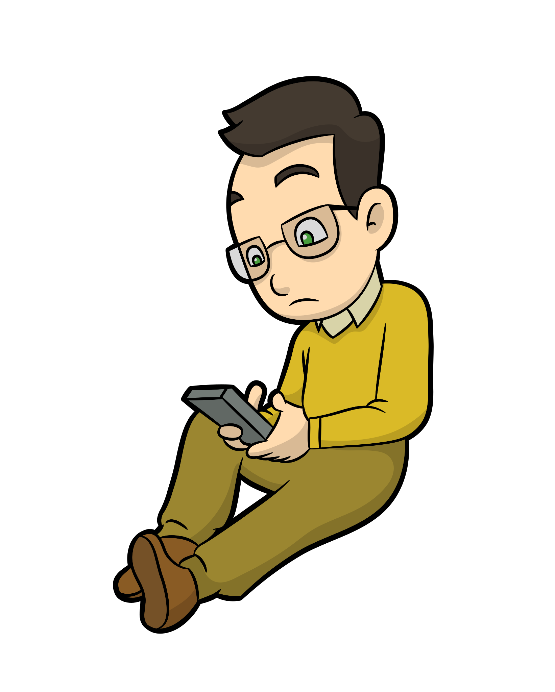

Personas (Based on 3 clusters)
Henry, Age 26
Patricia, Age 24
Bob, Age 23

Slide 41
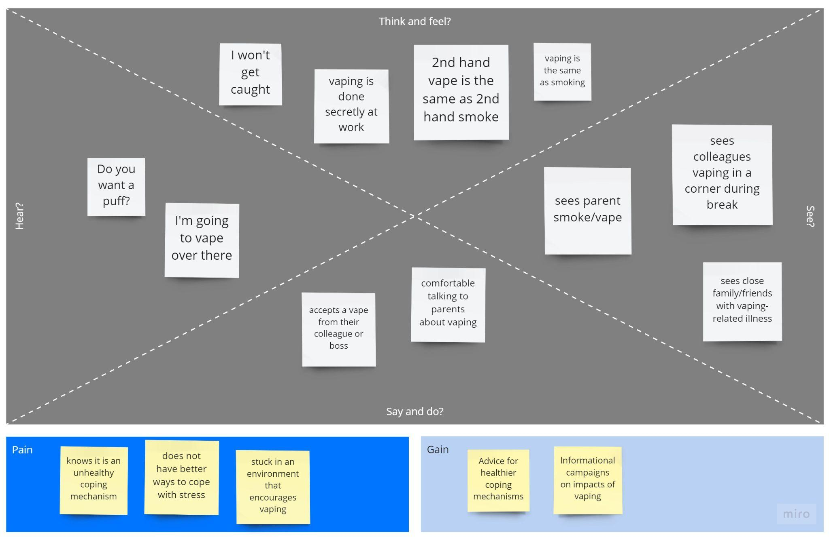
Heavy/First-time vapers (Cluster 0)
Henry, Age 26
Just got promoted to be a manager in the office
Has parents who smoke
Thinks vaping is the same as smoking
Vapes a pod a day to cope with the stress
Gets offered a vape by his colleagues when he does not bring his own
He would accept it

Slide 42
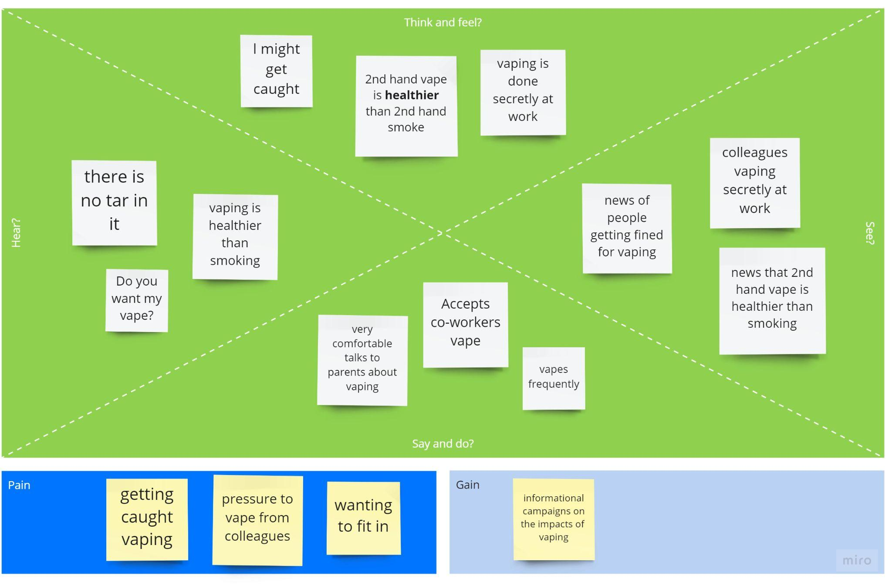
Frequent vapers (Cluster 1)
Patricia, Age 24
Works in the media sector
Trying to quit smoking
Convinced that vaping is a healthier alternative to smoking
Vapes frequently
Accept a co-workers vape if she forgot/did not bring her own

Slide 43
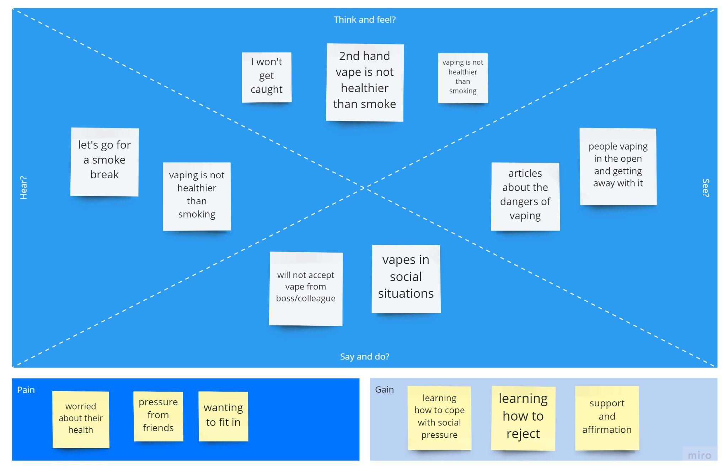
Social vapers (Cluster 2)
Bob, Age 23
Bob works in the government sector
He does not see any colleagues vaping
He knows that vaping is not healthier than smoking
He would not accept a vape at the workplace
He has a close group of friends that will take smoke breaks when they meet up
Bob does not reject a vape when passed to him to avoid being a wet blanket
He follows their lead despite knowing that it is not good for his health.

Slide 44
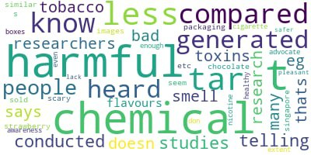
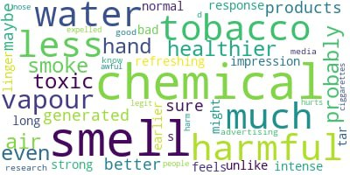
Modelling and Analysis - Word Clouds
Why vaping is healthier than smoking
Why second hand vape is healthier than second hand smoke
Surveyees believe the chemicals in vape juice to be healthier than the tar from cigarettes.
Surveyees believe that second hand vape is just water vapour.
Notes:
For word clouds we used the responses from our open ended questions.
After filtering out stop words we then processed the remaining words into word clouds.
The larger the word, the more it appeared in the responses.

Slide 45
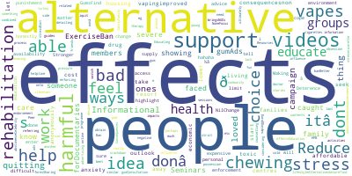
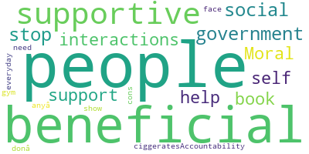
Modelling and Analysis - Word Clouds
Non-vapers on helpful resources
Vapers on helpful resources
Mainly focus on health effects of vaping, social pressure and alternative habits.
Vapers focus on social pressure as well as support from the government.

Slide 46
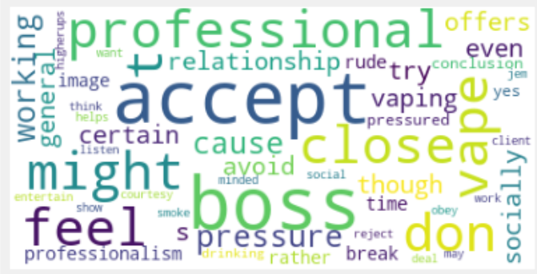
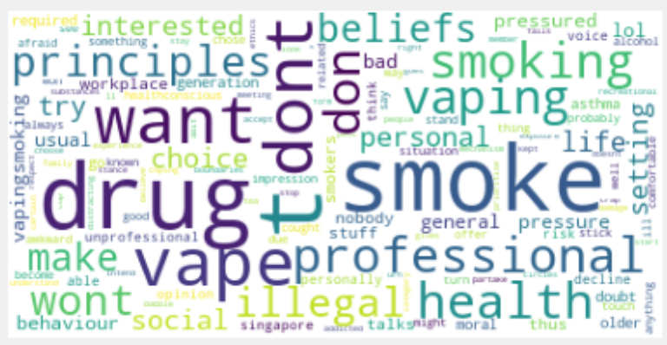
Modelling and Analysis - Word Clouds
Why would you accept an offer from your boss to vape
Why would you not accept an offer from your boss to vape

Slide 47
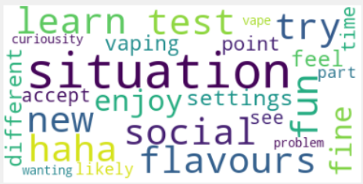
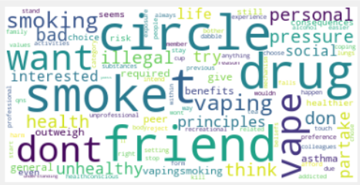
Modelling and Analysis - Word Clouds
Why would you accept an offer from colleagues to vape
Why would you not accept an offer from colleagues to vape

Slide 48
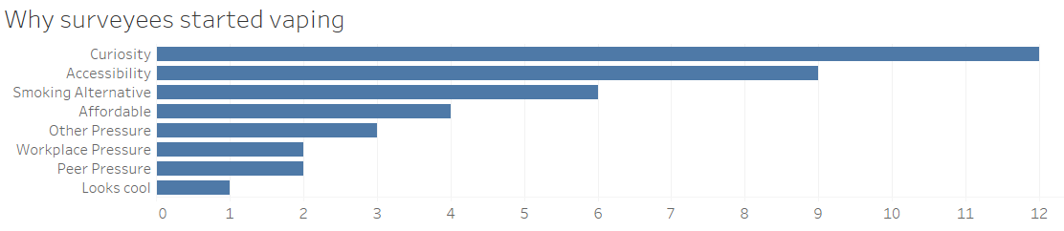
Modelling and Analysis
Majority of surveyees started vaping due to curiosity. These surveyees also mentioned they thought vaping was healthier.
Notes:
Tried one-time and social?

Slide 49

We also asked further questions on why the choose to continue vaping after trying vapers, most of them talk about how it is more user-friendly, more accessible. A number of people also mentioned coping mechanisms such as helping with stress and anxiety.

Slide 50



Modelling and Analysis- Topic Modelling
Import libraries: Gensim
Load excel sheet
Clean excel sheet
spaCy model: nlp = en_core_web_md.load()
Tag Removal:
Create Dictionary with tokens, filter and create corpus for lda model
Coherence score to decide topics
Low coherence: chose 5 topics

Slide 51

Modelling and Analysis- Topic Modelling
Use lda model to print topics:
Check lda_model[corpus] is working against data set
Print gensim model:

Slide 52
Modelling and Analysis- Topic Modelling
Attach most likely topic to each data point
Count total of each topic
Conclusion:
Did not use topic modelling since coherence was too low and responses in dataset were too short, causing modelling to be ineffective.
Many respondents have single word or short sentence answers which heavily affected accuracy of model.

Slide 53


Modelling and Analysis- Topics
Why people do not quit
What resources are needed
Vapers feel addicted and quit for for their health.
Emphasis on health consequences, vaping alternatives like gum and need for support.
Notes:
Why surveyees think people do not quit
Surveys on resources needed to quit

Slide 54
Modelling and Analysis - Quitting
Reasons to Quit
Perceived health effects ( 6/12 mentioned this)
Addiction (feeling bad about over-reliance)
Disappointment to others
Waste of money
Difficulties faced
Not perceived as unhealthy / no incentive
Too enjoyable / addiction
Had never considered quitting
Reasons to quit and difficulties to quit are two sides of the same coin.
Notes:
Surveyees who are active vaper that tried to quit
Largely contributed by addiction/health perhaps it is related in a sense because even though they know it’s bad for their health, they are too addicted to quit. Therefore we need more outlets so these people can learn to cope with their addiction and stay away from vaping.

Slide 55
Modelling and Analysis - Quitting
Unsuccessful
Social circle includes many friends that vape
Stopped buying vapes but turned back to smoking instead
Reasons: high levels of addiction, peer pressure, convenience
Successful
Social circle includes many friends that vape
Stopped buying vapes and did not repurchase but would accept from friends
Reasons: Was not addicted in the first palace, tried out of curiosity

Slide 56
Solution development-Cluster preferences
Cluster 0 (Heavy/First-time vapers)
Environment that encourages vaping
Has colleagues and parents that smoke/vape
Benefit from social intervention and support
Benefit from informational campaigns to help their loved ones
Cluster 1 (Frequent vapers)
Thinks vaping is healthier than smoking
Benefit from informational campaigns to target their lack of awareness towards the detrimental effects of vaping
Cluster 2 (Social Vapers)
Has close group of friends that take smoke breaks
Unsure how to reject them despite knowing vaping is unhealthy
Benefit the most from social intervention and support

Slide 57

Linking back to sponsor’s problem statements
Raise awareness on the consequences of vaping through multiple channels:
Social media campaigns [ Tiktok / Instagram ]
Advertisements on transportation
Interviews with ex-vaper who suffer ( understand the POV)
Partner program to help cope with addiction
Again, understand how difficult it is to deal with nicotine addiction
Can be kept in check
Know someone out there is concerned about them
Notes:
https://www.start.io/audience/tiktok-users-in-singapore
https://publications.gc.ca/site/archivee-archived.html?url=https://publications.gc.ca/collections/collection_2021/sc-hc/H14-359-2021-eng.pdf

Slide 58
Solution
Raise Awareness
Pair Motivation
On the consequences of vaping through multiple channels:
Social media campaign
Advertisement with Influencer
Interview with ex-vaper who suffered -> know POV
Get a close family member or friend to join them on a journey for quitting to be kept in check
Motivation from love ones are more impactful than from groups

Slide 59

Solution development-
Application of thinking hats
-From our survey, we found that people suggested showing consequence of vaping like harmful effects.
-From our survey, we also found that addiction is the most popular topic when asked why they did not stop.
-YWAs are not willing to be educated/get the help they need because they are too deep into the addiction
-YWAs successfully quit vaping through our campaigns/support groups and lead healthier lives
-YWA do not find the campaigns/ support groups effective and quit the program.
- Start a campaign to educate YWA on harmful effects of vaping
- Ask influencer that are their age group to convey the message
- Have pair support like a close family member or friend to ensure accountability
-What do vapers want out of the solution.?
-Do they really want to quit?
-What has been the success rate of past efforts by the government?

Slide 60

Solution development -Blue Ocean Strategy
Eliminate
Reduce
Raise
Create
Notes:
Campaigns we referenced:
Wake-up campaign California (stillblowingsmoke website): https://stillblowingsmoke.org/
Truth Initiative: https://truthinitiative.org/
Disturbing content has no effect:
https://www.rand.org/blog/2014/09/graphic-warning-labels-on-cigarettes-are-scary-but.html
Broadcast Media TV source shows that young working adults are not on TV:
https://www.channelnewsasia.com/commentary/vaping-smoking-gateway-addiction-disease-youth-children-3027926 (CNA, 2022)
Not enough articles to cover harmful effects on vaping:
https://www.bbc.com/news/health-63076876 (BBC, 2022)
https://pubmed.ncbi.nlm.nih.gov/32670575/ (national library of medicine, 2020)
Disturbing Content → Disturbing Imagery commonly used in such campaigns, such as wake up campaigns still blowing smoke website backgrounds. Tries to elicit fear in vapers about the health risks.
BroadCast TV, Radio → TV/ Radio ads
Social Media → Social Media ads
Grants for Research → Wake up campaign provided funding to colleges to do research on the health implications of vapes.
Relatability → Making it more relatable to young working adults
Continuous Support → Getting a buddy to support your quitting, who can be friends or family which you are together with a lot of the time.

Slide 61

Solution Development / Innovation and Recommendations
Detailed version of our BOS

Slide 62
Thank you!
Any Questions?

